Slide 1
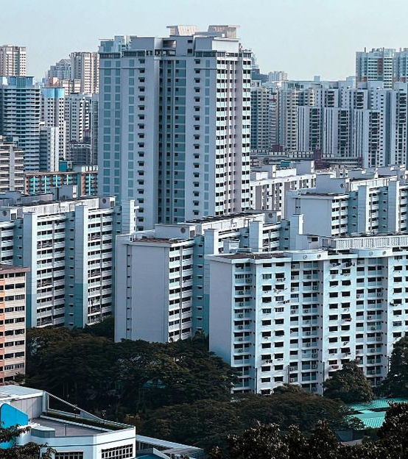
SC1015 Mini Project
HDB Resale Flat Price Analysis in Singapore
Lim wei jian, David U2430324H
See Pei jin, ernest U2430223J
Lab ECDS group 2

Slide 2

content
Introduction
Problem Definition
Data Extraction and Cleaning
Exploratory Data Analysis
Machine Learning
Conclusion

Slide 3
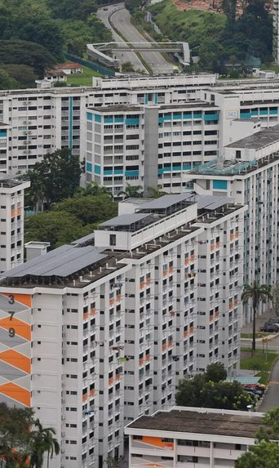
introduction
HDB resale flats are a major part of Singapore’s housing market
In 2024, there were 27835 recorded transactions of resale flats in Singapore. That’s about 76 transactions a day.
Resale flat prices are determined by the different attributes of a flat
Introduction

Slide 4
Problem definition
Can we
Develop a data-driven model to predict HDB resale prices based on relevant features
And
Classify if the resale price people pay is fair or unfair
Problem Definition

Slide 5
Problem definition
Why do we want to predict the resale price?
Important for homebuyers, sellers, real estate agents, and policymakers to gauge the value of resale flats
Why is it important to determine if the price is “fair”?
Allows for informed negotiations to give both buyer and seller confidence in pricing fairness
Ensuring affordability and accessibility for first time buyers
Problem Definition

Slide 6
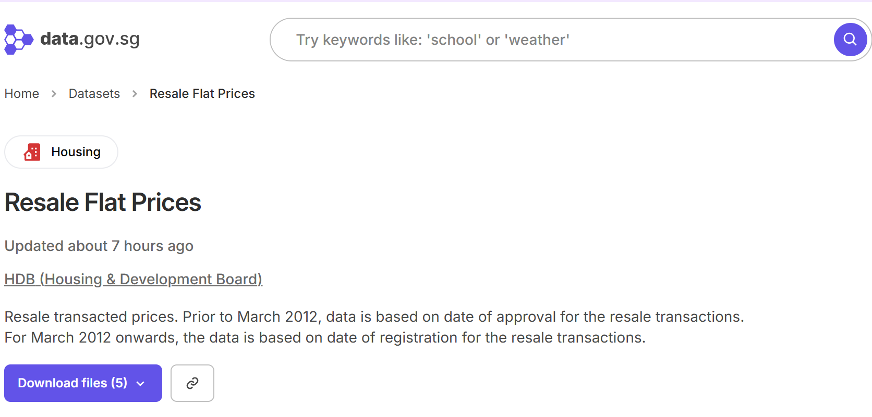
Data set used
(From Jan 2017 to 17 March 2025)
Problem Definition

Slide 7
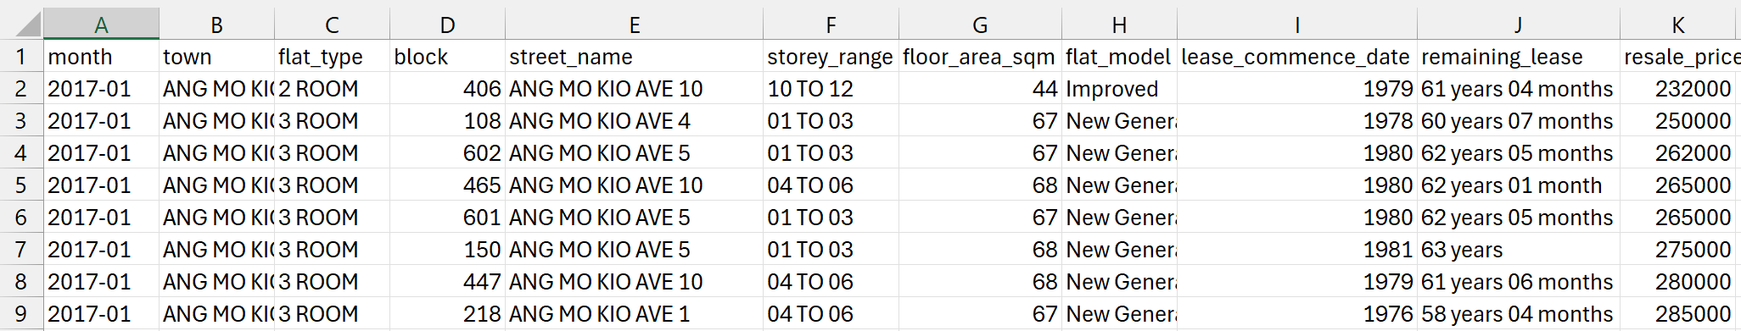
Data set used
Problem Definition

Slide 8

Data extraction and cleaning

Slide 9
Extraction and Cleaning of Data
Dropping of irrelevant columns
Converting Remaining Lease to Float
Creating a New Variable: Price per square Meter
Perform One-Hot Encoding on categorical data
Data Extraction and Cleaning

Slide 10
Dropping of irrelevant columns
Data Extraction and Cleaning

Slide 11
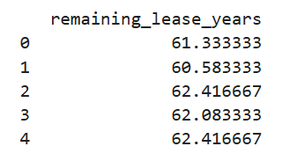
Converting Remaining Lease to Float
Data Extraction and Cleaning

Slide 12
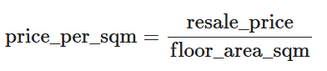
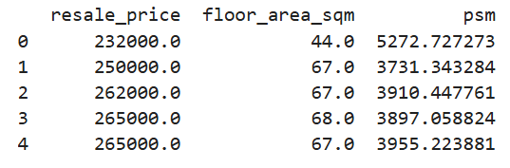
Creating a New Variable: Price per square Meter
Data Extraction and Cleaning

Slide 13



One hot encoding for categorical data
One Hot Encoding is a method for converting categorical variables into a binary format.
The primary purpose of One Hot Encoding is to ensure that categorical data can be effectively used in machine learning models.
town
storey_range
flat_type
Data Extraction and Cleaning

Slide 14

Exploratory Data Analysis
Overview of Resale Flat Distribution
Univariate Analysis with Respect to Resale Price

Slide 15
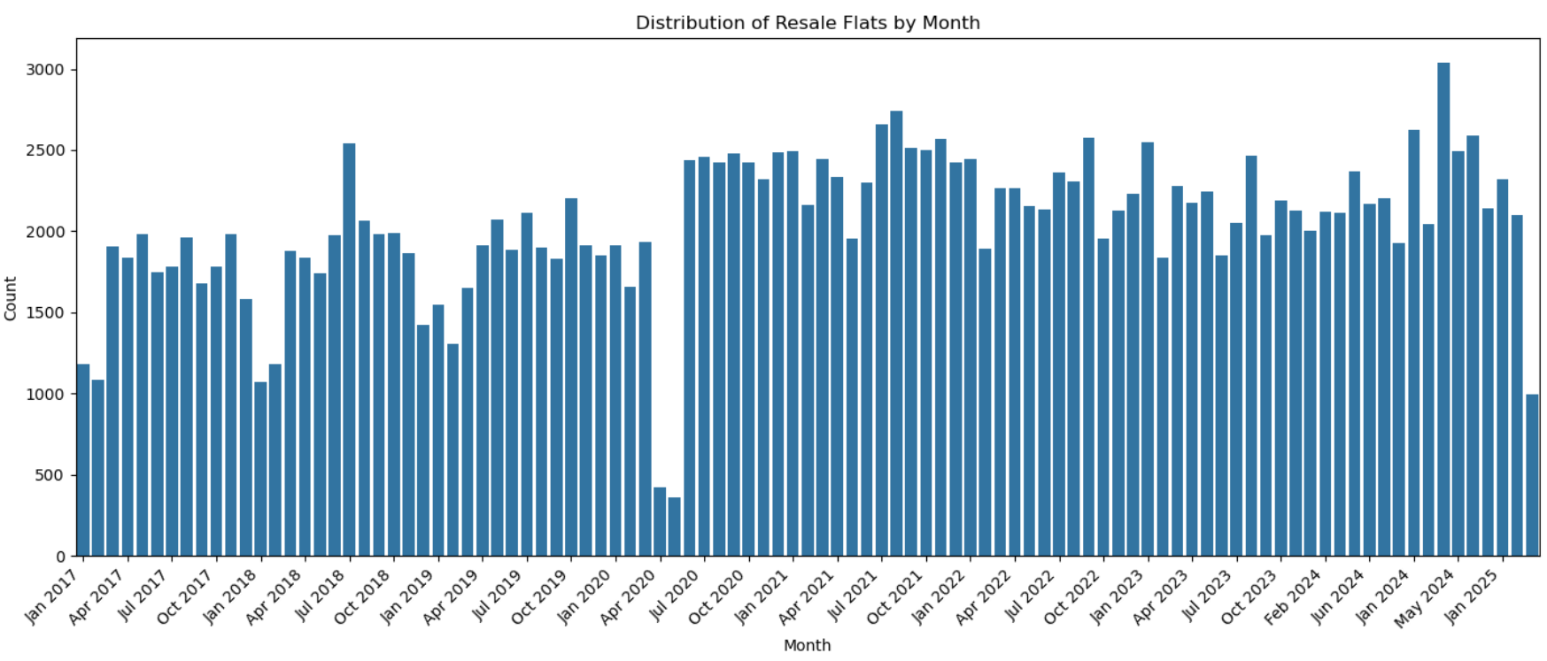
Resale flats sold by month
Exploratory Data Analysis (Overview of Resale Flat Distribution)

Slide 16
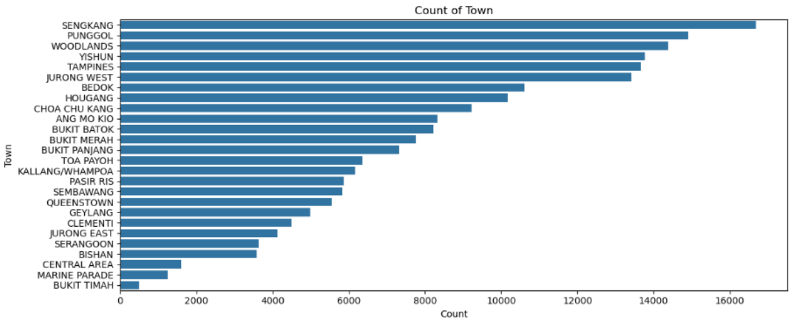
Resale flats sold by town
Exploratory Data Analysis (Overview of Resale Flat Distribution)

Slide 17
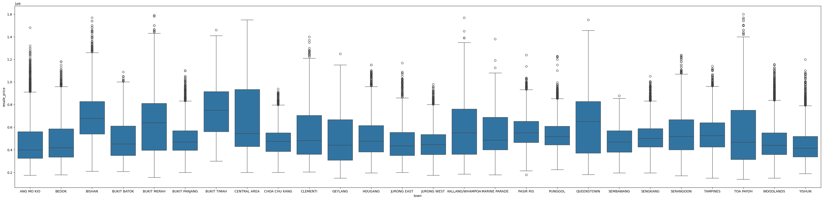
Resale price in each town
Exploratory Data Analysis (Univariate Analysis with Respect to Resale Price)

Slide 18
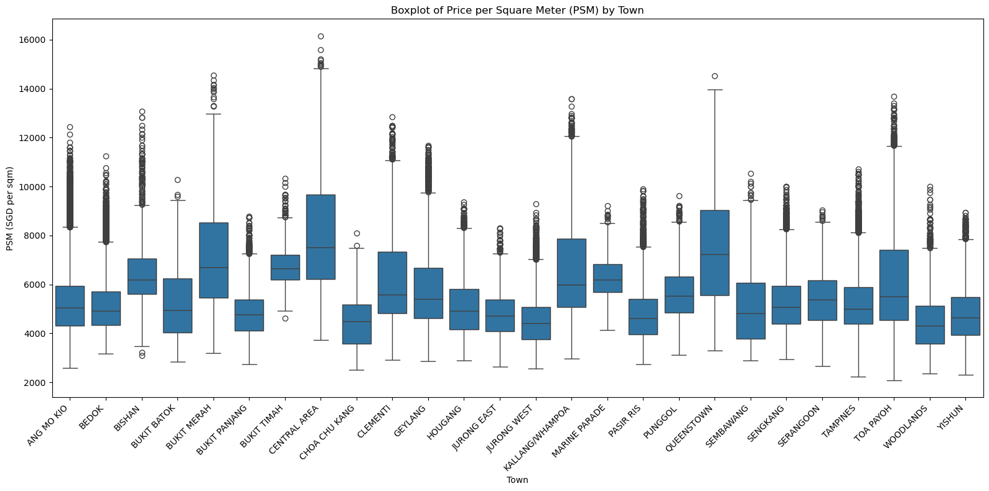
Resale price in each town
Exploratory Data Analysis (Univariate Analysis with Respect to Resale Price)

Slide 19
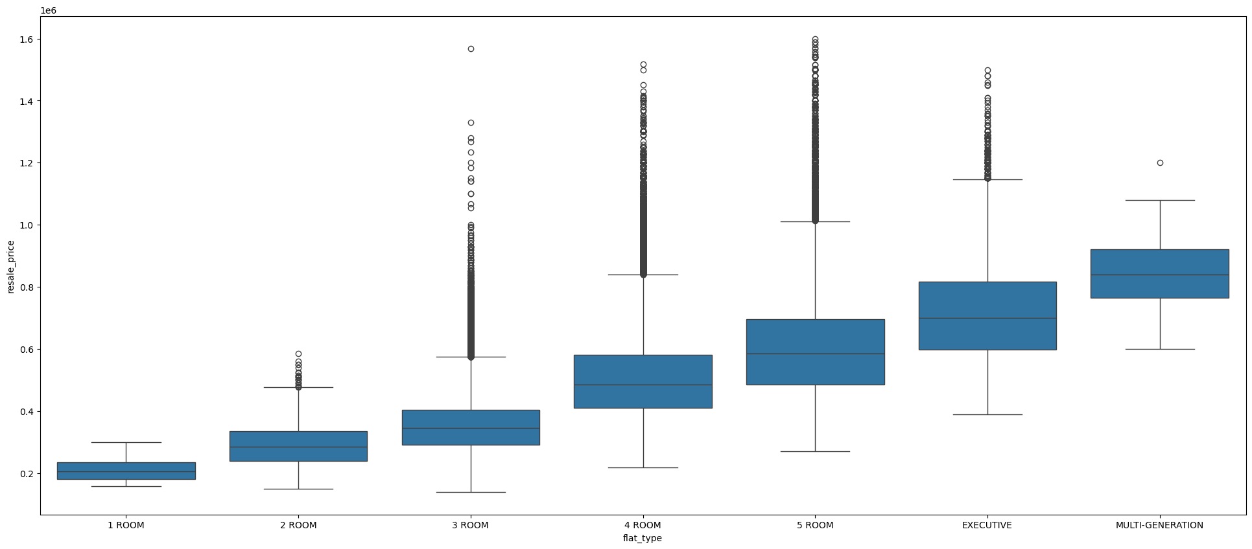
Resale price for each flat type
Exploratory Data Analysis (Univariate Analysis with Respect to Resale Price)

Slide 20
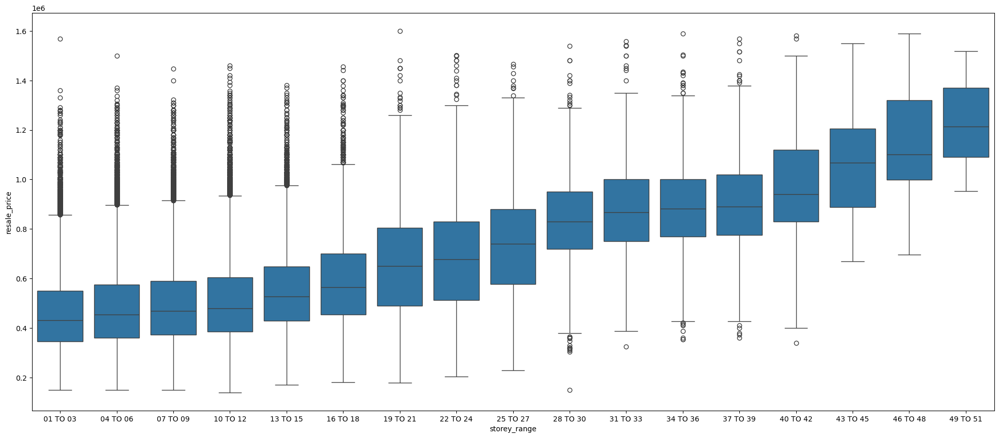
Resale price for each storey range
Exploratory Data Analysis (Univariate Analysis with Respect to Resale Price)

Slide 21
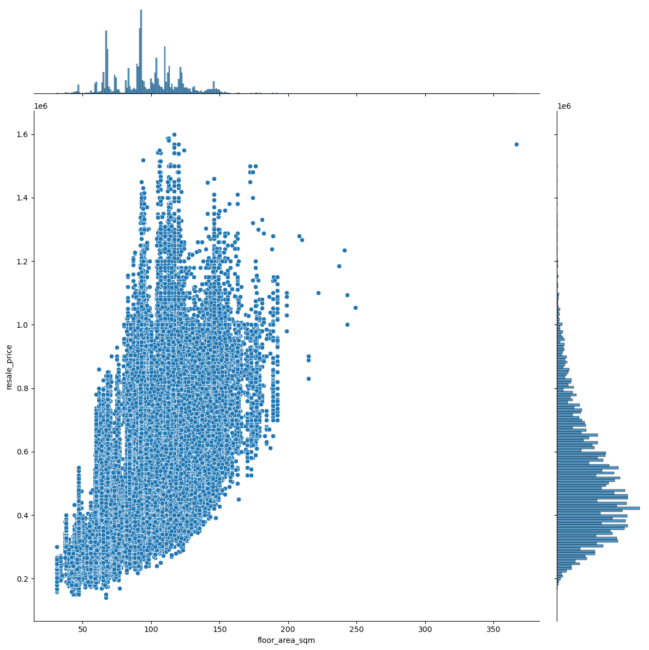
Resale price for floor area
Exploratory Data Analysis (Univariate Analysis with Respect to Resale Price)

Slide 22
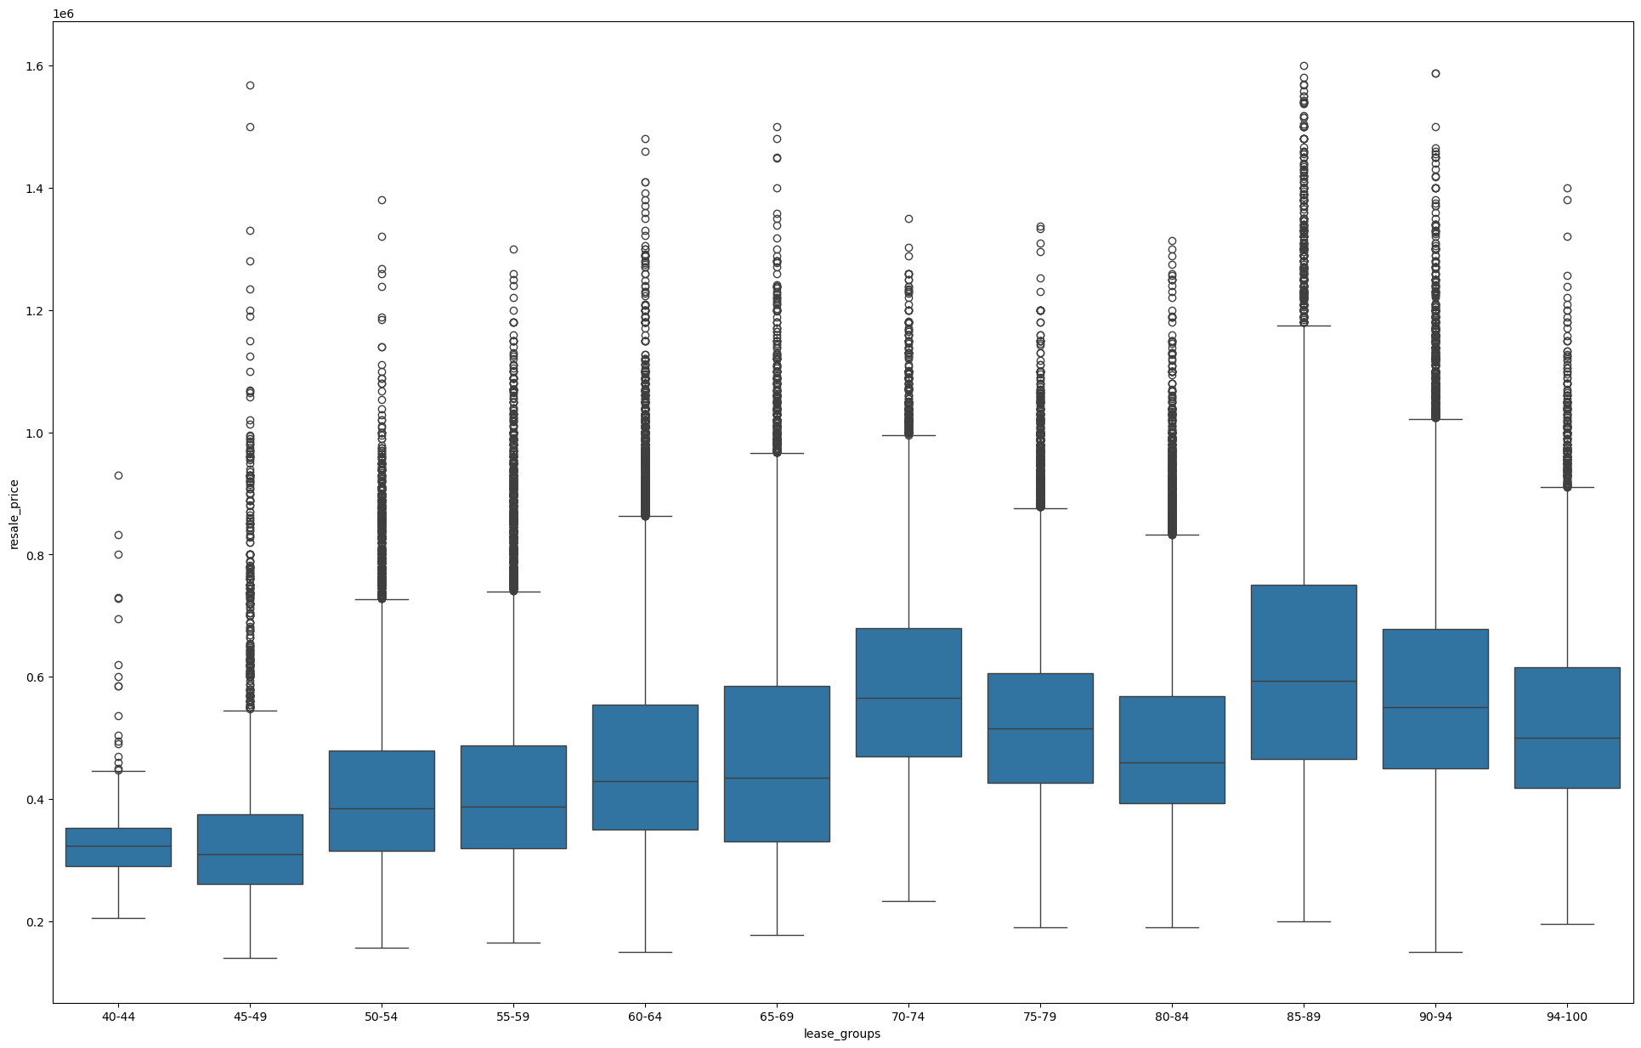
RESALE PRICE FOR REMAINING LEASE YEARS
Exploratory Data Analysis (Univariate Analysis with Respect to Resale Price)

Slide 23
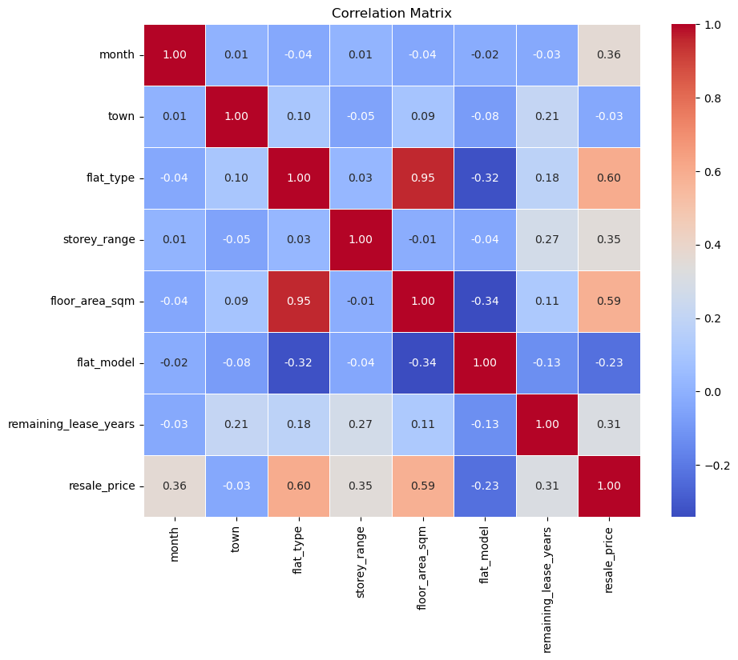
CORRELATION MATRIX
Exploratory Data Analysis (Correlation Matrix)

Slide 24

Machine Learning
Linear Regression
Univariate
Multivariate
Random Forest
Regression
Classification

Slide 25

Regression Models
1. Linear Regression
Univariate
Multivariate
Random Forest Regression

Slide 26
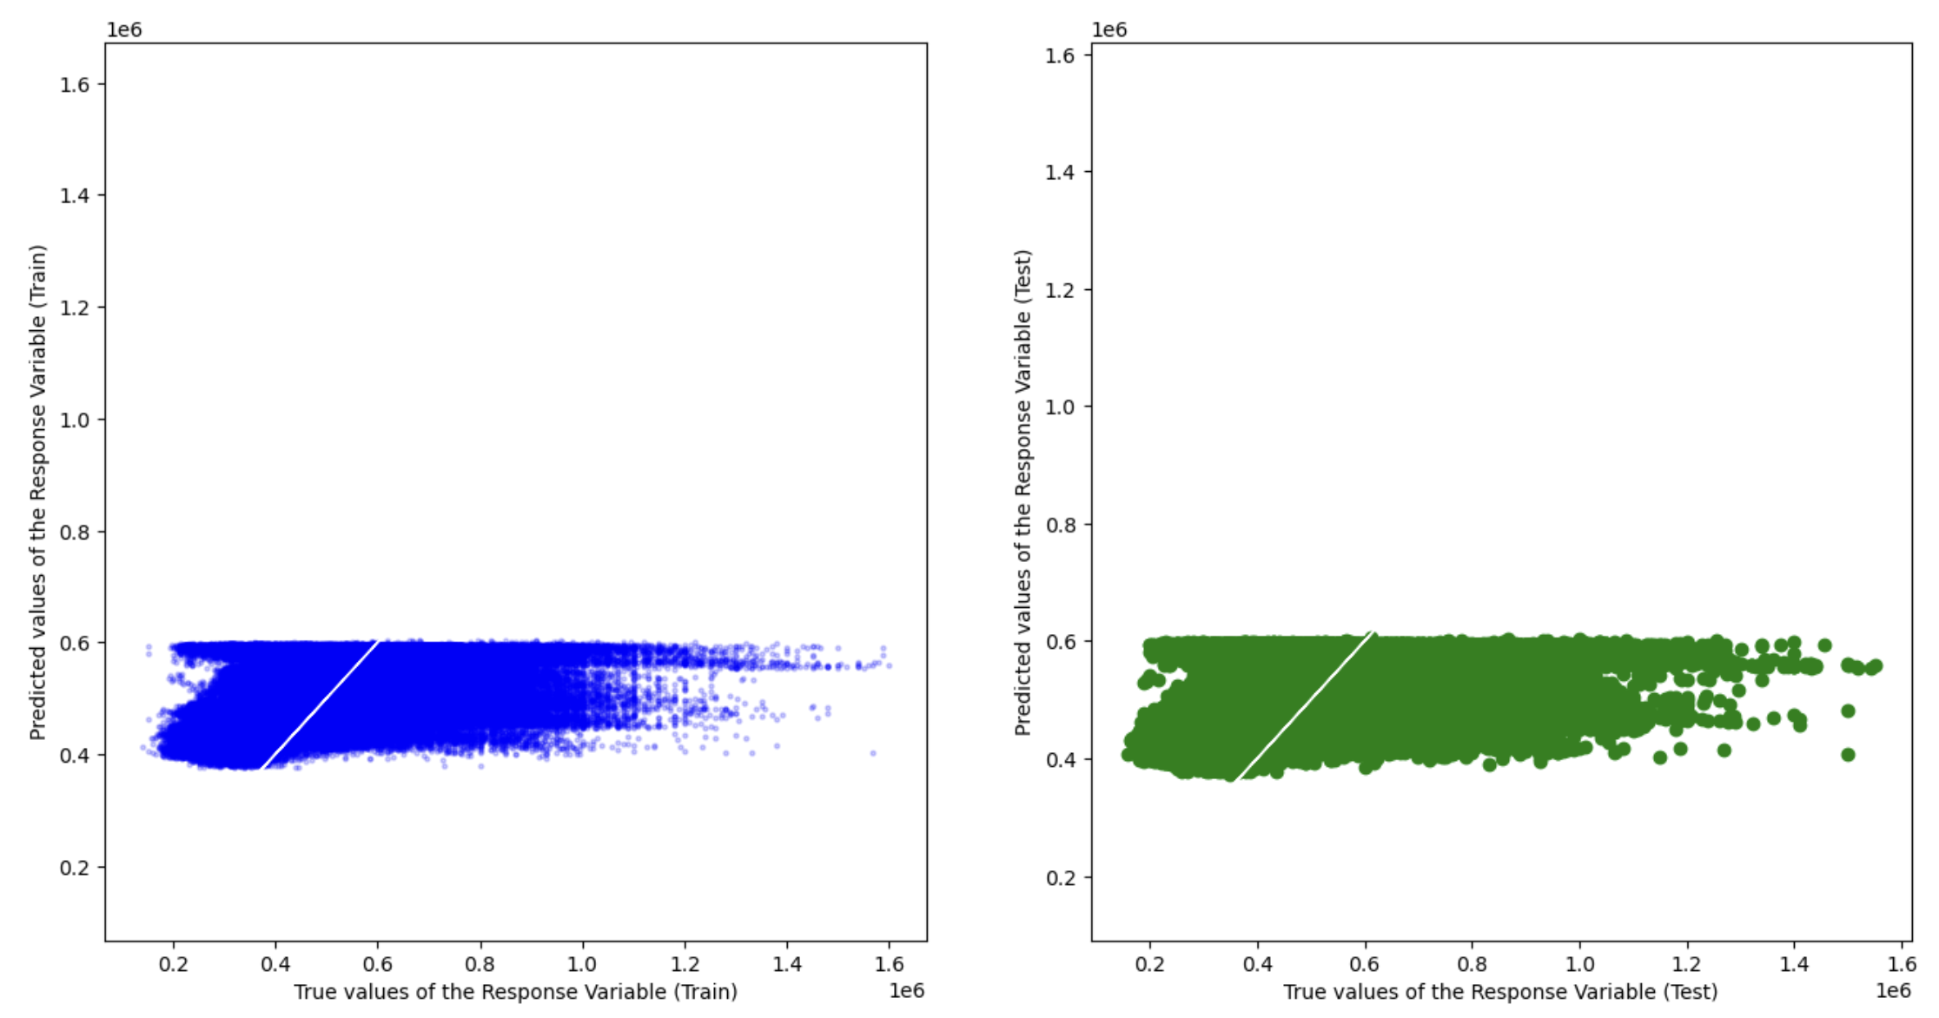
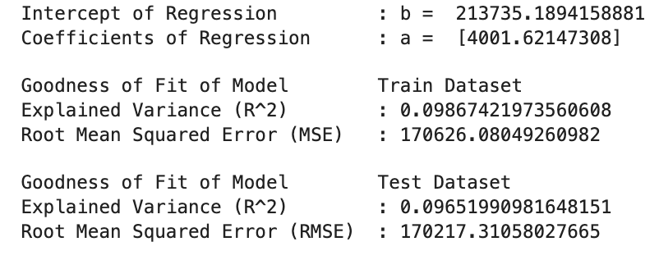
Predictor Feature: Remaining Lease Years
Univariate Linear Regression

Slide 27
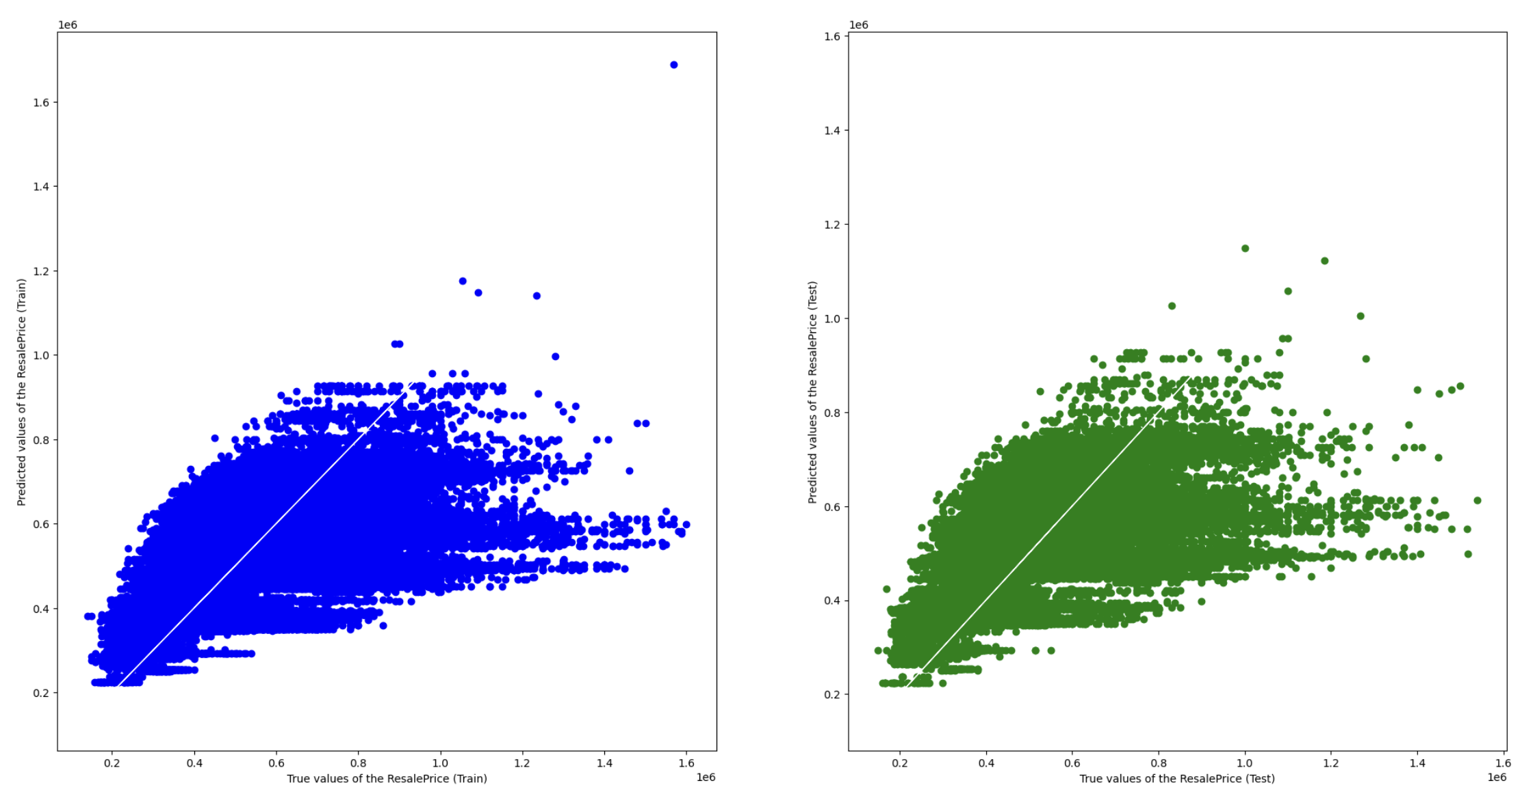
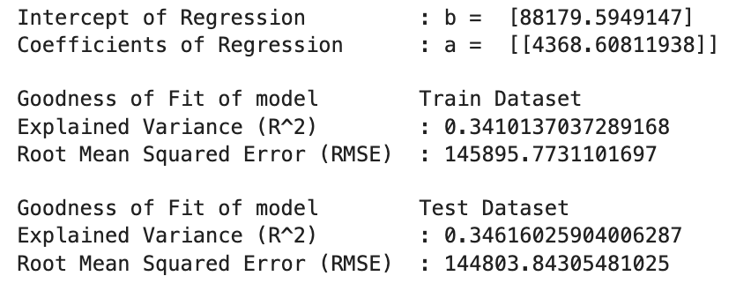
Predictor Feature: Floor Area
Univariate Linear Regression

Slide 28
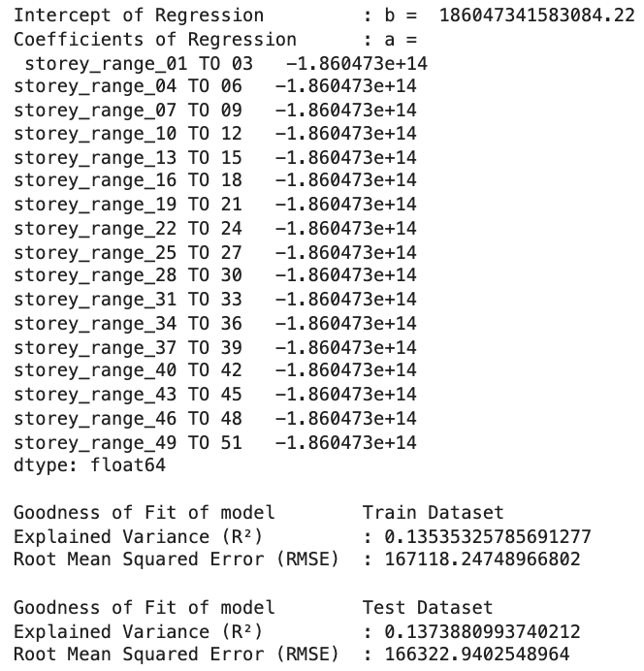
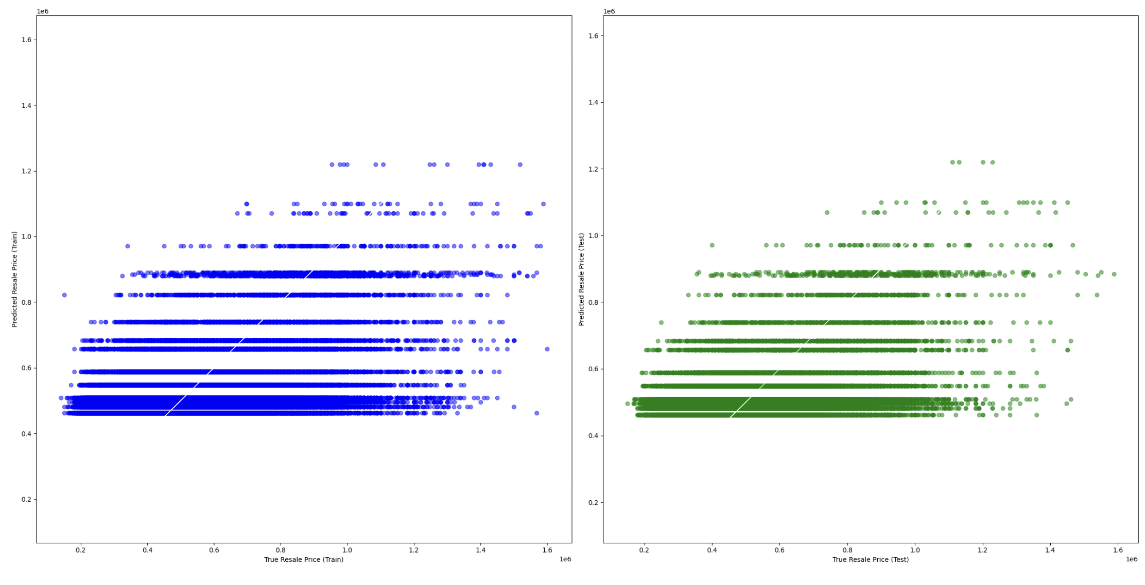
Predictor Feature: Storey Range
Univariate Linear Regression

Slide 29
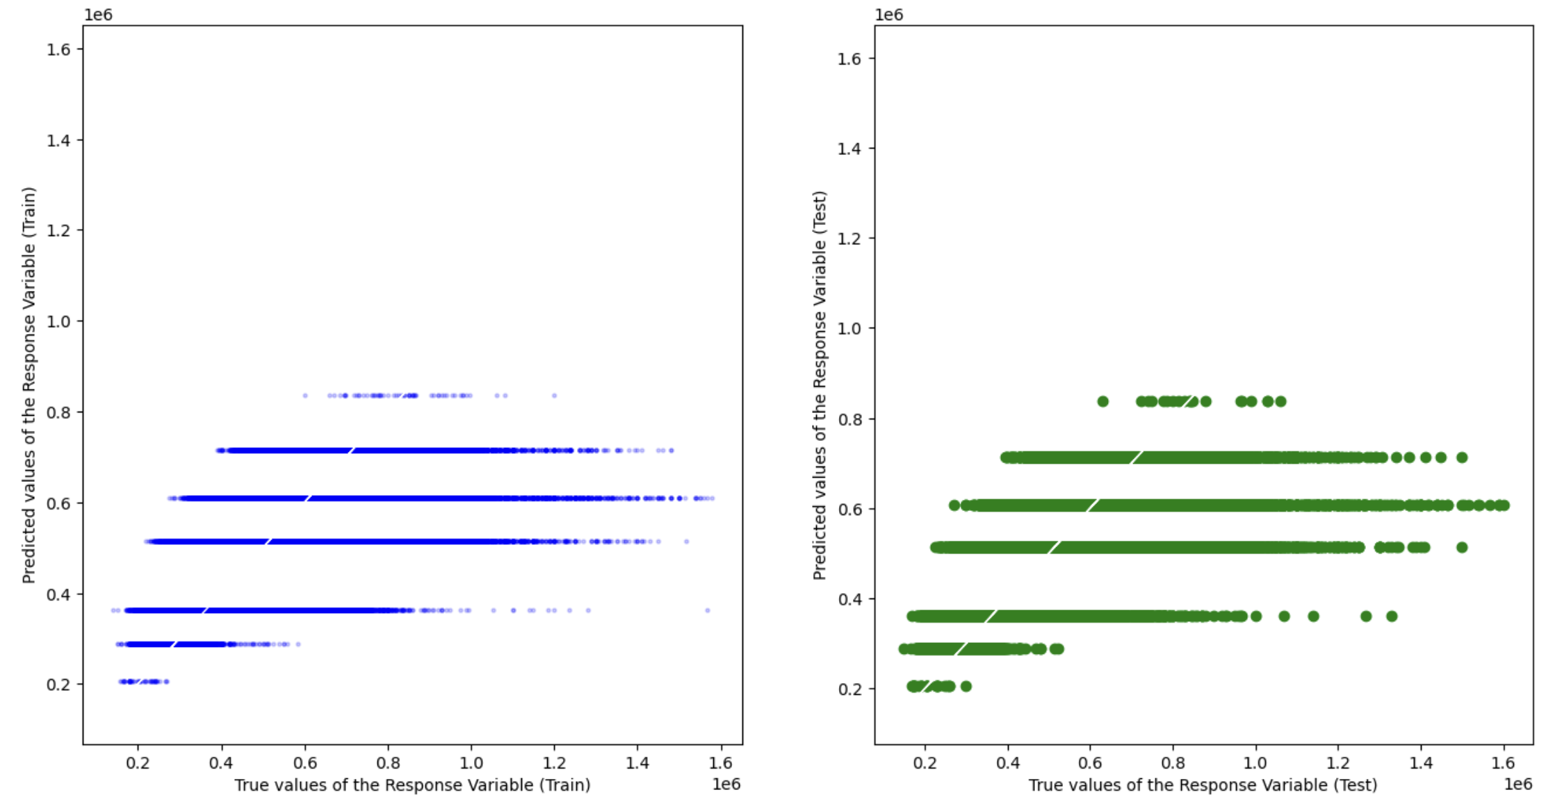
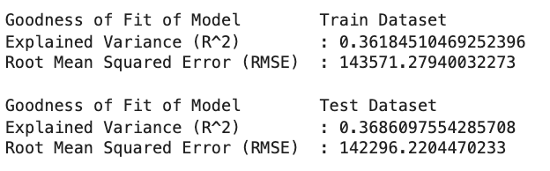
Predictor Feature: Flat Type
Univariate Linear Regression

Slide 30
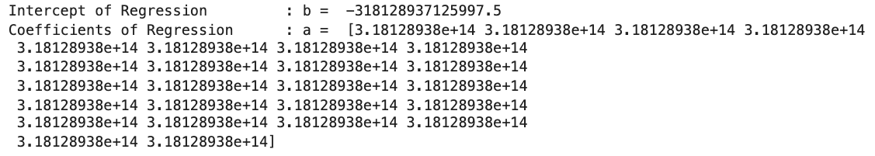
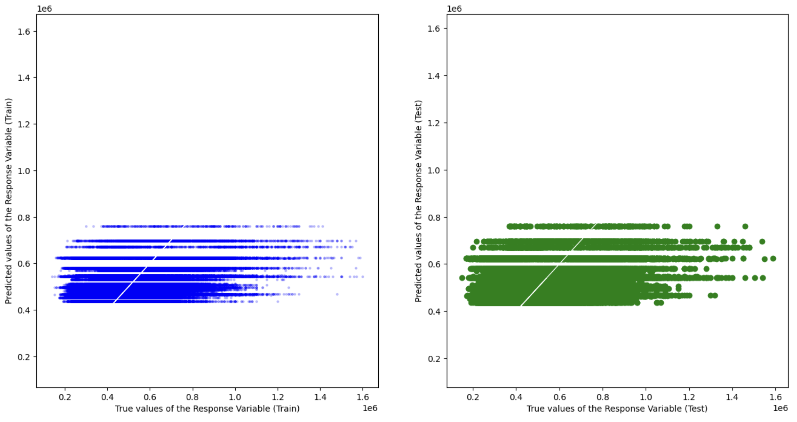
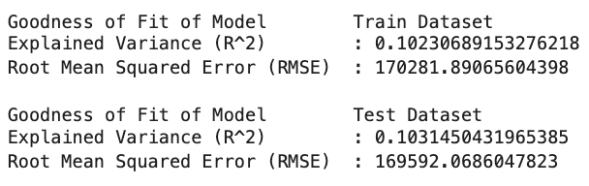
Predictor Feature: Town
Univariate Linear Regression

Slide 31
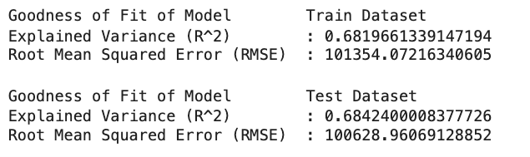
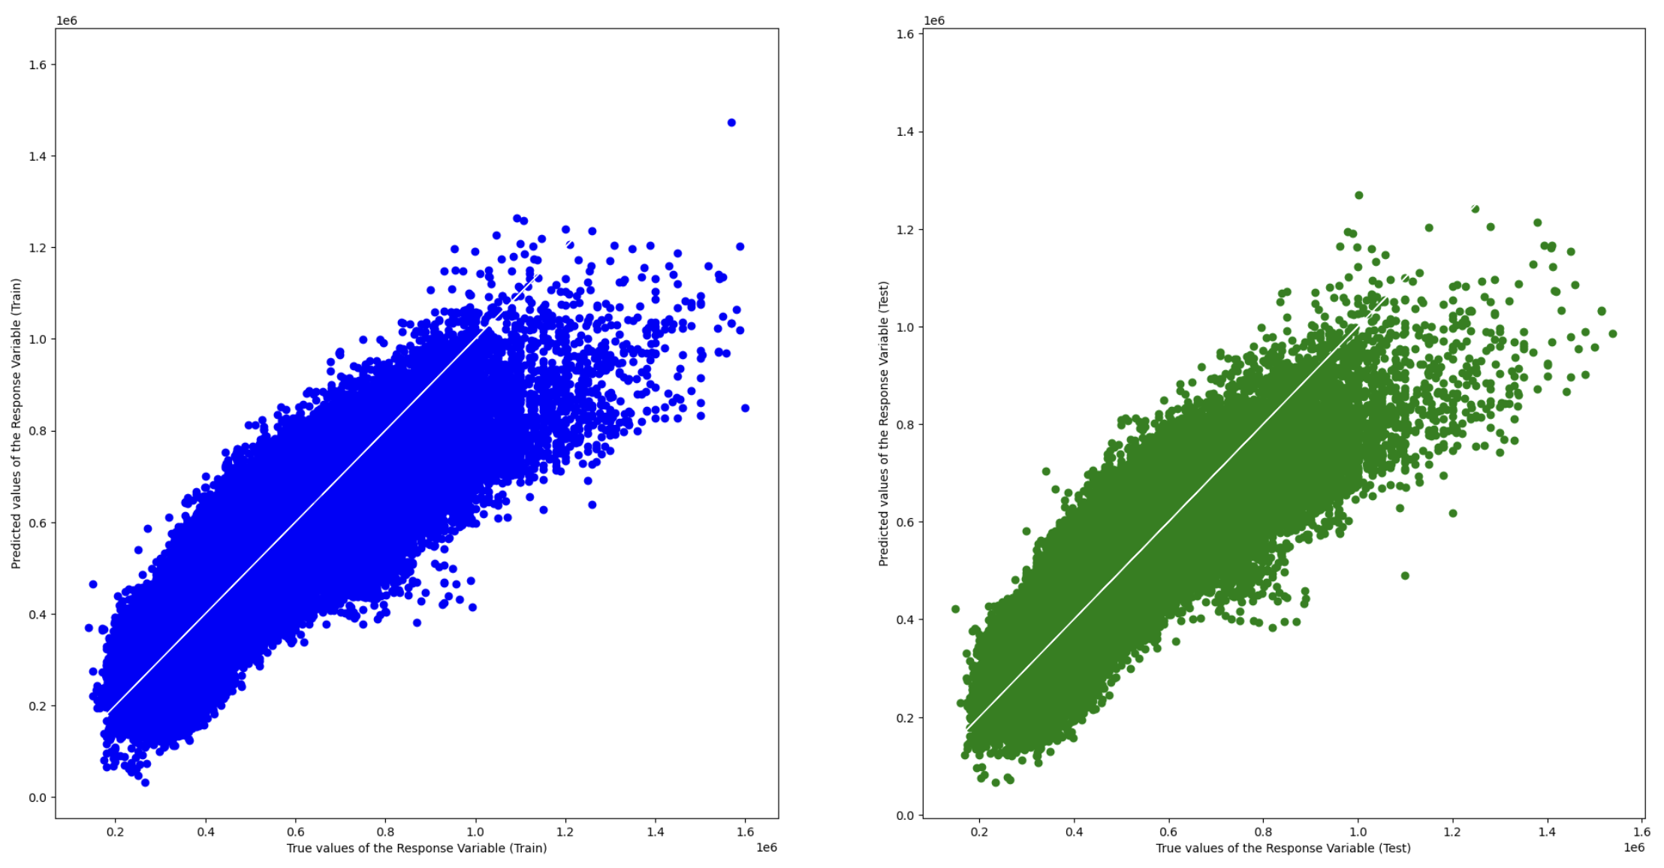
Multi-Variate Linear Regression
Predictor Features:
Floor Area
Remaining Lease Years
Storey Range
Flat Type
Town
Multi-variate Linear Regression

Slide 32
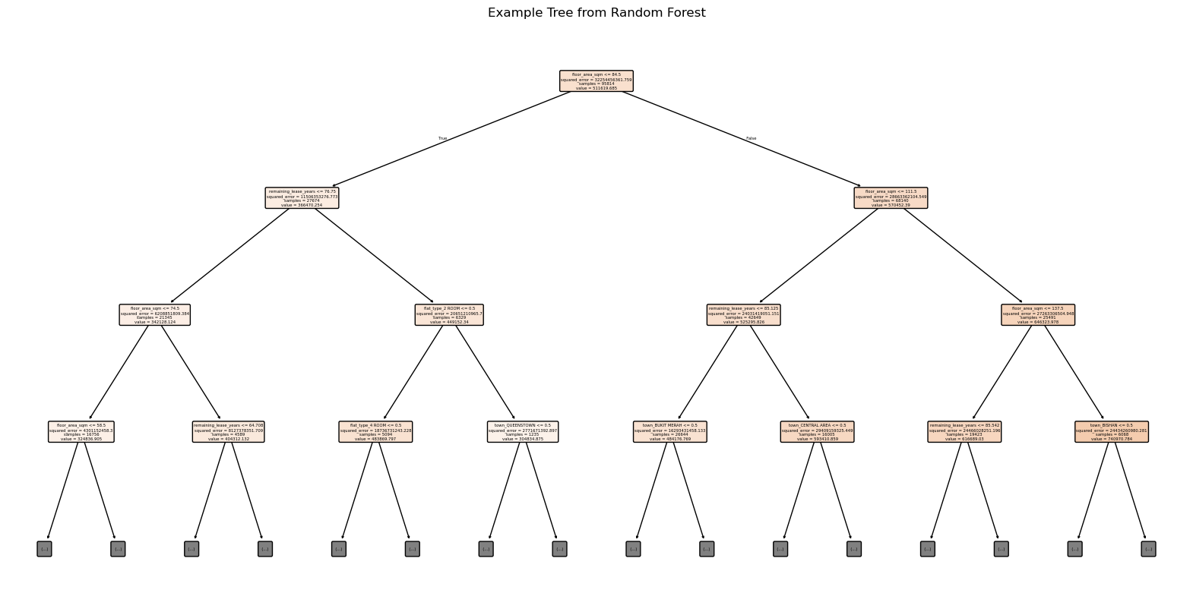
Random Forest Regression
Random Forest Regression

Slide 33
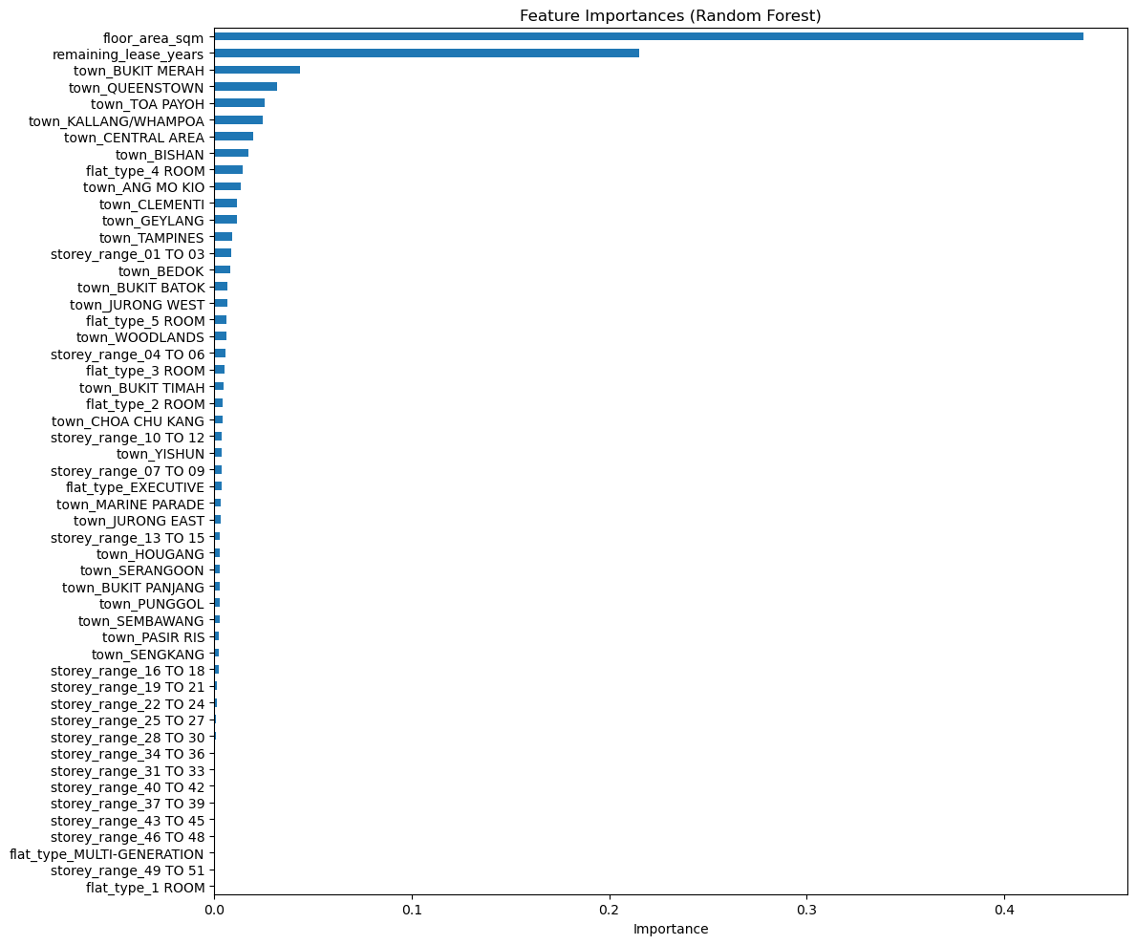
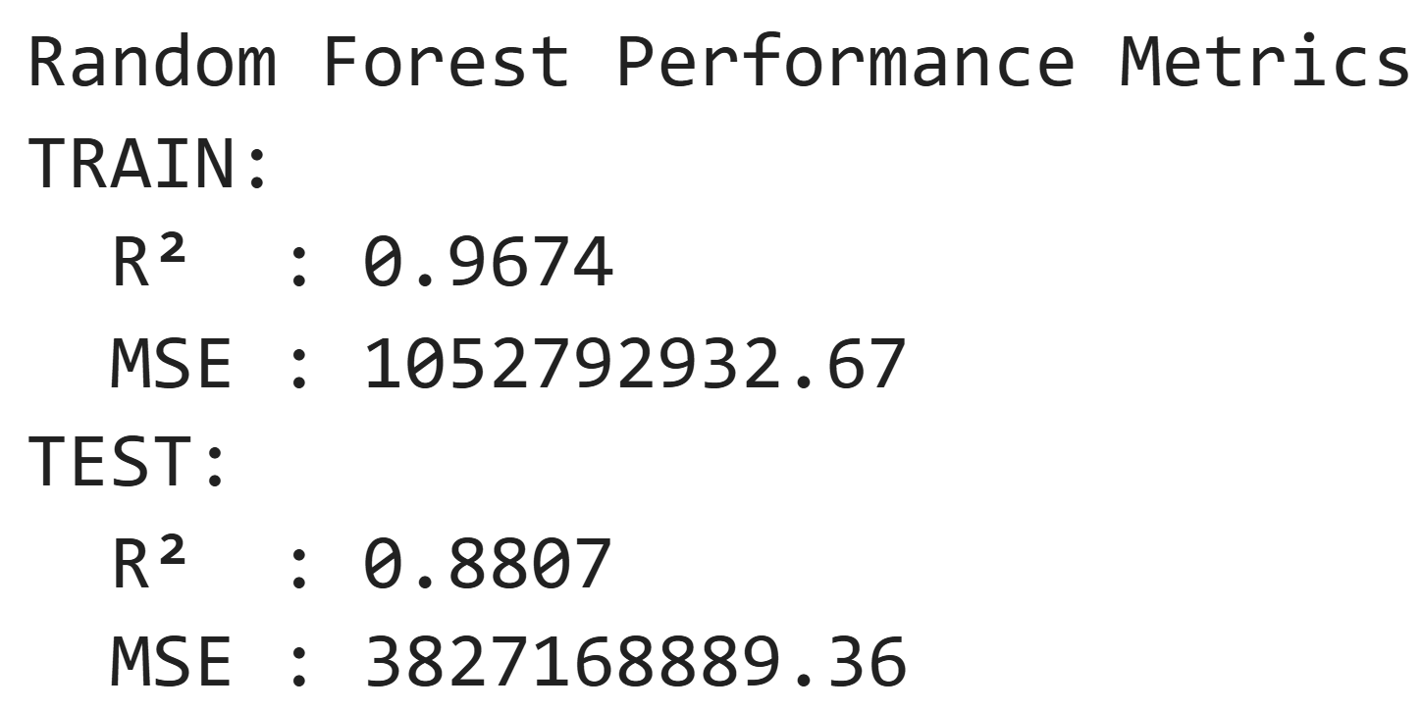
Random Forest Regression
Random Forest Regression

Slide 34
Multi-Variate Linear Regression VS Random Forest Regression
Model | Multi-Variate Linear Regression | Random Forest Regression
R² (Train) | 0.682 | 0.967
RMSE (Train) | 101,354 | 32,446
R² (Test) | 0.684 | 0.881
RMSE (Test) | 100,628 | 61,864
Random Forest Regression

Slide 35

Random Forest classification

Slide 36
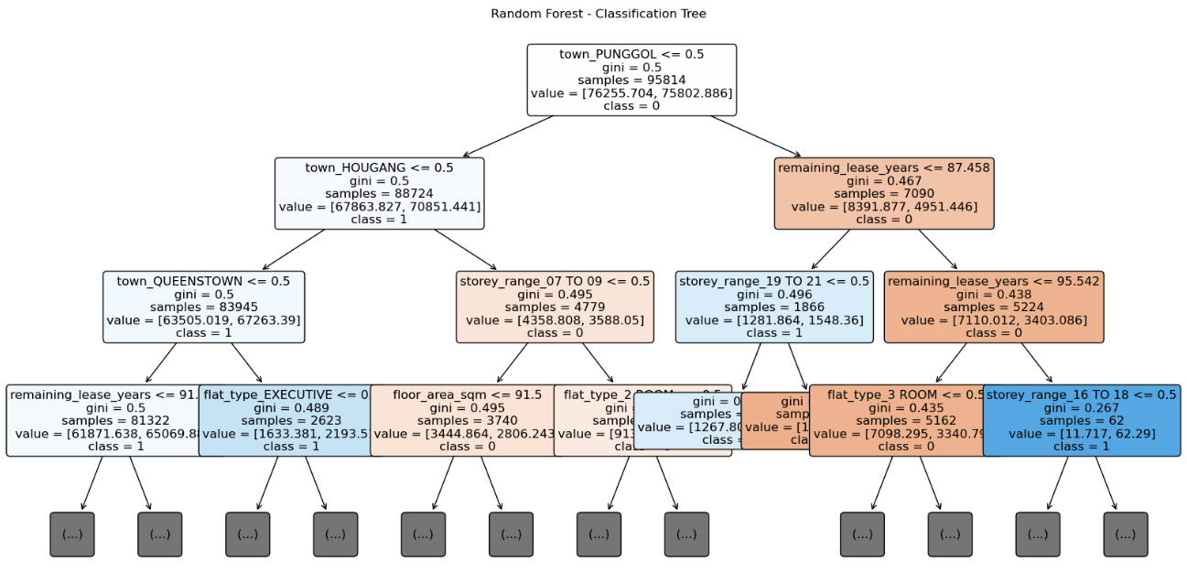
Random Forest Classification

Slide 37
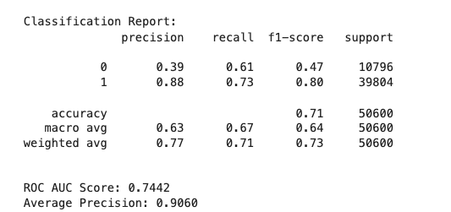
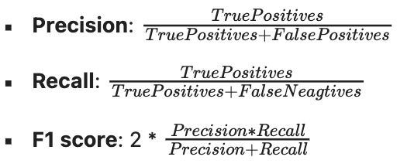
Random Forest Classification

Slide 38
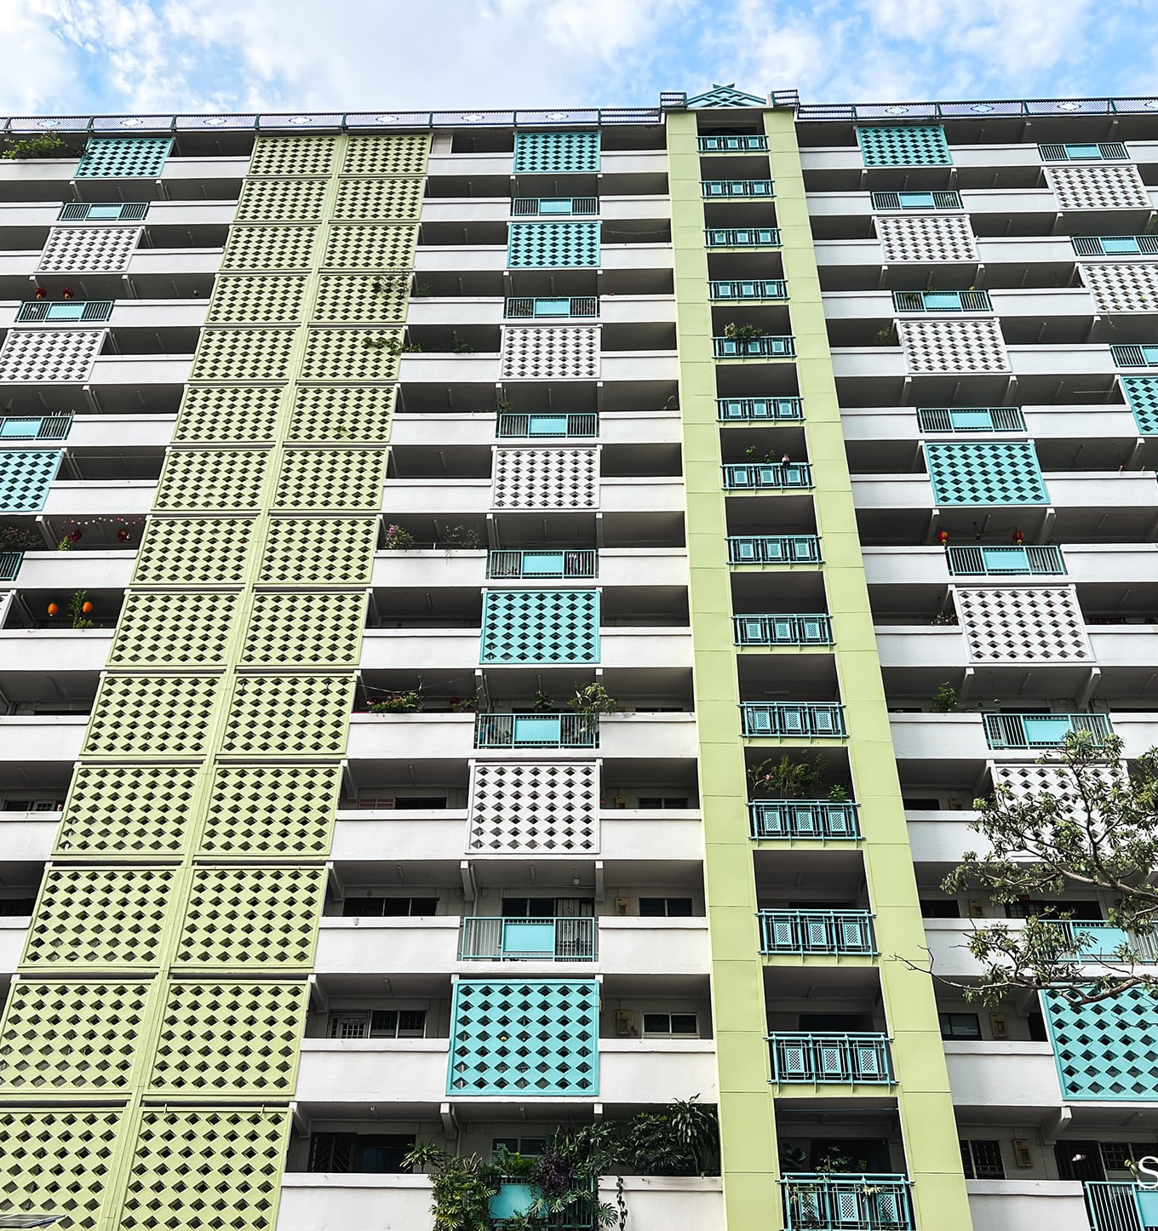
Conclusion

Slide 39
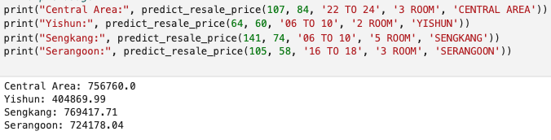
Conclusion
Outcome
We were able to develop a predictive model for HDB Resale prices using a Random Forest Regression model which performed significantly better than Multivariate Linear Regression
Conclusion
Notes:
## Project Outcome & Insights
### ✅ Outcome
- We successfully built a predictive model for HDB **resale prices** using features such as floor area, remaining lease, storey range, town, and flat type.
- Among the models tested, **Random Forest Regressor** performed the best, achieving an **R² score of ~0.60**, outperforming Linear Regression (R² ~0.50).
- A **classification model** was also developed to assess whether a flat’s resale price is **“fair”**, based on how close it is to the predicted value.
### 📊 Insights
- **Floor area** and **remaining lease** are the strongest predictors of resale price.
- Town-level pricing shows that central and mature towns (e.g., Queenstown, Bukit Merah) have higher prices and price per sqm.
- **Flat type** and **storey range** also impact price, with larger flats and higher storeys commanding a premium.
- Resale prices show a **clear upward trend** over time, with increasing variability in recent years.
### 💡 Recommendations
- Buyers should pay closer attention to **price per sqm** as a better indicator of flat value, rather than total resale price alone.
- Policymakers may consider location-based interventions to support affordability in high-cost towns.
- Future versions of the model can incorporate **temporal effects**, **amenity proximity**, and **policy events** for improved prediction accuracy.
Overall, the project met its objective of uncovering key pricing drivers and developing a tool that aids in both **price prediction** and **fairness assessment**.

Slide 40
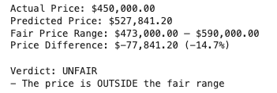
Conclusion
Outcome
- We then successfully implemented a Random Forest Classification model that assessed the fairness of our price predictions
Conclusion
Notes:
## Project Outcome & Insights
### ✅ Outcome
- We successfully built a predictive model for HDB **resale prices** using features such as floor area, remaining lease, storey range, town, and flat type.
- Among the models tested, **Random Forest Regressor** performed the best, achieving an **R² score of ~0.60**, outperforming Linear Regression (R² ~0.50).
- A **classification model** was also developed to assess whether a flat’s resale price is **“fair”**, based on how close it is to the predicted value.
### 📊 Insights
- **Floor area** and **remaining lease** are the strongest predictors of resale price.
- Town-level pricing shows that central and mature towns (e.g., Queenstown, Bukit Merah) have higher prices and price per sqm.
- **Flat type** and **storey range** also impact price, with larger flats and higher storeys commanding a premium.
- Resale prices show a **clear upward trend** over time, with increasing variability in recent years.
### 💡 Recommendations
- Buyers should pay closer attention to **price per sqm** as a better indicator of flat value, rather than total resale price alone.
- Policymakers may consider location-based interventions to support affordability in high-cost towns.
- Future versions of the model can incorporate **temporal effects**, **amenity proximity**, and **policy events** for improved prediction accuracy.
Overall, the project met its objective of uncovering key pricing drivers and developing a tool that aids in both **price prediction** and **fairness assessment**.

Slide 41
Conclusion
Insights
Floor area and remaining lease years were the strongest predictors of resale price
About 78% of homebuyers pay a fair price for their HDB resale flat, suggesting that the real estate market is relatively efficient
According to our model, the mean absolute difference between predicted and actual resale price was $27,000
Certain towns such as Bukit Merah and Queenstown were shown to have a noticeable impact on resale prices, likely due to their premium location
Conclusion

Slide 42
Conclusion
Recommendations
Purchasing a resale flat is a lifelong investment that requires careful planning and analysis before making such an expensive decision.
Overall, we hope to provide homebuyers as well as sellers with a model that helps make rational and informed decisions using past real-life data provided by the housing development board.
Adding geospatial data points such as proximity to amenities, transportation hubs and schools can help us achieve more accurate predictions
Conclusion

Slide 43
Conclusion
Takeaways
Always room for growth: Initially, we thought that using linear regression was sufficient in predicting resale price. However, we went beyond the syllabus, incorporating random forest regression which was a significantly better model
The importance of evaluation metrics: Utilizing evaluation metrics is important in helping us understand how well our models are performing and guides improvements
Not everything is what it seems: According to our model, 22% of transactions in the HDB dataset are “unfair”. When exploring datasets, we should analyse the data closely rather than taking them at face value as some data points may be skewed, even if its data from a reliable source like the government
Conclusion

Slide 44
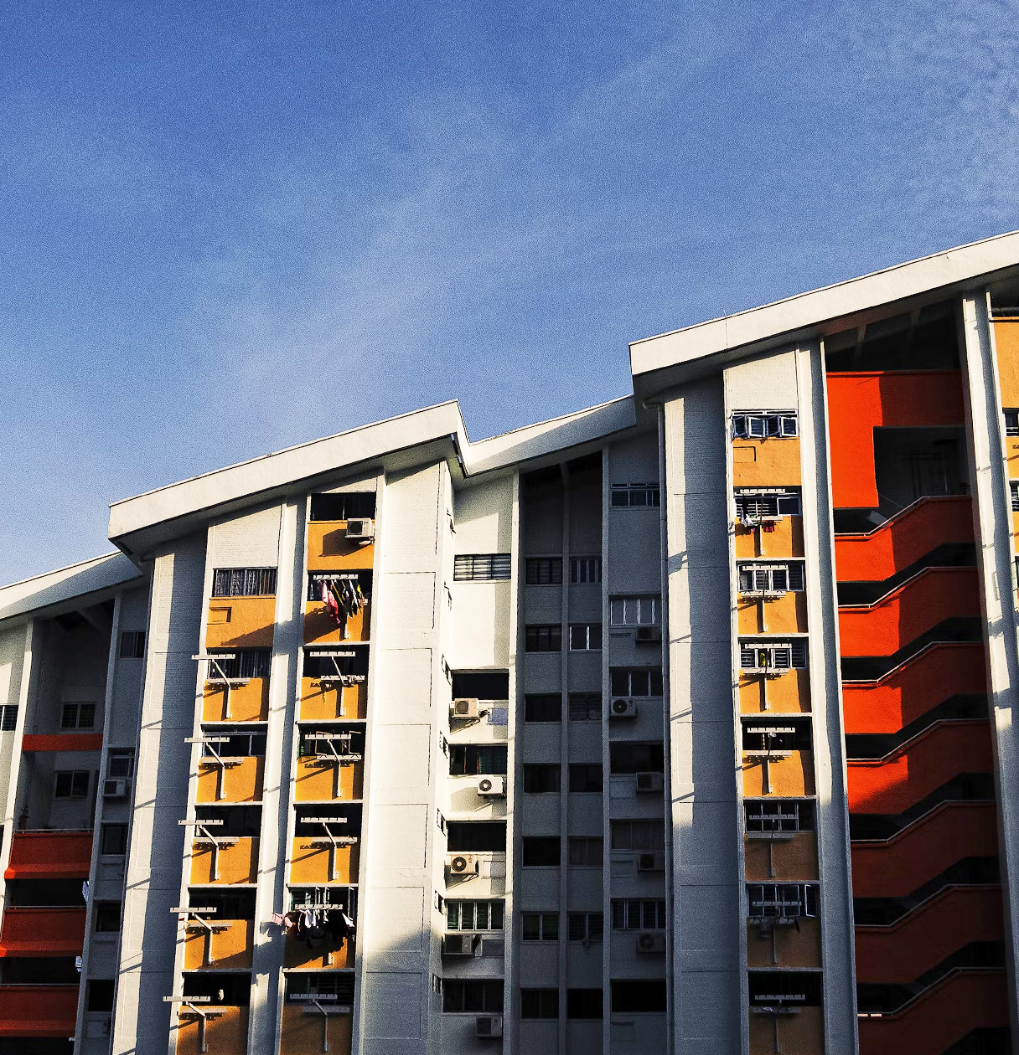
Thank You!
Presented by
Lim Wei Jian, David (U2430324H)
See Pei Jin, Ernest (U2430223J)

